Slide 1

Wi-Fi
School of Computer Science Engineering and Technology Bennett University
Greater Noida – 201310

Slide 2
WiFi
WiFi Security: WEP, WAP, WAP2
Outline

Slide 3
Wireless Fidelity (Wi-Fi) allows us to connect to the Internet from anywhere (without wires) within the range of a base station.
Types of Wi-Fi:
IEEE 802.11b : Max. transfer speed is 11Mbps, operate within 100-150 feet. Used in cordless phones and in microwave oven.
Wi-Fi/WLAN
IEEE 802.11a: Max transfer speed is 54 Mbps, operates in 5GHz band, perform better in high density area.
IEEE 802.11g: operates within 100-150 feet, 2.4 GHz radio frequency, extremely fast, speed of 15-20 Mbps

Slide 4
Introduction: WLAN
A wireless LAN (WLAN) is a :
flexible data communication system implemented as an alternative for a wired LAN within a building or campus.
combine data connectivity with user mobility without losing connectivity.
Flexible:
reconfigure /add more nodes to the network without much planning effort and cost of re- cabling.
Two types of network topologies:
– ad hoc and infrastructure.

Slide 5
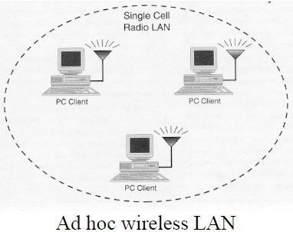
WLAN Topology : Ad hoc
An adhoc topology supports p2p connectivity where mobile nodes communicate directly with each other using wireless adapters.
Ideal for meetings or setting up of temporary workgroups.
It has disadvantage of limited coverage area

Slide 6














Ad hoc network architecture
The basic service set (BSS) consists of group of stations using the same radio frequency and is the basic building block of an IEEE 802.11 LAN.
STA₁
BSS1
The Independent BSS (IBSS) is the simplest may consist of as few as two stations.
IBSS is also called the ad hoc mode in WLAN.
The ovals can be thought of as the coverage area within which member stations can directly communicate.
Station (STA) is the terminal with access mechanisms to the wireless medium and can directly communicate with a limited range.
LAN. It
STA₂
ad-hoc network
BSS2
STA
STA₄
3
STA₅
6

Slide 7
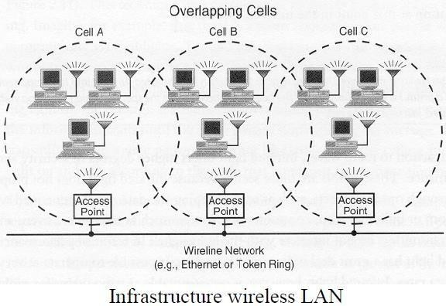
WLAN Topology : Infrastructure
Use an access point that controls :
transmission and assigns priority
levels
monitors network load and
allows mobile stations to roam from cell to cell.
It handle traffic from a mobile station to another mobile station within the coverage area or to the wired backbone.

Slide 8
Infrastructure WLAN components
Station (STA): terminal with access mechanisms to the wireless medium and radio contact to the access point
Basic Service Set (BSS): group of stations using the same radio frequency
Access Point: station integrated into the wireless LAN and the distribution system
Portal: bridge to other (wired) networks
Distribution System: interconnection network to form one logical network (ESS: Extended Service Set) based on several BSS

Slide 9
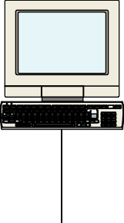


WLAN in the TCP/IP stack
fixed terminal
mobile terminal
server
infrastructure network access point
application
application
TCP
TCP
IP
IP
LLC
LLC
LLC
802.11 MAC
802.11 MAC
802.3 MAC
802.3 MAC
802.11 PHY
802.11 PHY
802.3 PHY
802.3 PHY

Slide 10

Types of Wireless Security
Unsecured
WEP
WPA
WPA2
Why use wireless encryption?
Additional Security Measures for your router
Wi-Fi: Security

Slide 11
A wireless network with no sort of encryption algorithm applied.
Any user can readily authenticate and access the internet.
Packets are unencrypted and visible.
Unsecured
Attacks:
o
ARP Spoofing
- Associate attacker's MAC address with default
gateway's IP. All traffic meant for gateway goes through attacker's machine first. Traffic can be passed through (passive sniff) or modified and passed (MIM).
o
Firesheep -
Firefox extension that decodes cookies on unsecured
network. Allows log in as user for sites like Facebook and Twitter.

Slide 12
WEP: Wired Equivalent Privacy
Deprecated security algorithm for IEEE 802.11 networking.
Introduced as part of original 802.11 protocol in 1997.
Standard 64 bit - WEP uses 40 bit key. Other 24 bits is IV.
Can also use 128/256 bit protocols.
IV (Initialization Vector) - prepended onto packets and is based on pre-shared key.
Such short IVs in 64 bit caused reuse of IVs with same key, which significantly shortened key cracking times of WEP.
Attacks:
Aircrack-ng - Linux command line tool. Sniffs packets on a network to obtain IVs and breaks WEP key using information present in the IVs. Can be done in less than 10 minutes.

Slide 13
WPA: Wi-Fi Protected Access
Flaws in WEP known since January 2001 - flaws include weak encryption (keys no
longer than 40 bits), static encryption keys, lack of key distribution method.
In April 2003, the Wi-Fi Alliance introduced an interoperable security protocol known as WiFi Protected Access (WPA).
WPA was designed to be a replacement for WEP networks without requiring hardware
replacements.
WPA provides stronger data encryption (weak in WEP) and user authentication (largely missing in WEP).
Also supported AES encryption
Designed to be backward compatible with older hardware after firmware upgrades
4-Way Handshake and Group Key Handshake

Slide 14
WPA: Wi-Fi Protected Access II
WPA includes Temporal Key Integrity Protocol (TKIP) and 802.1x mechanisms.
The combination of these two mechanisms provides dynamic key encryption and mutual authentication
TKIP adds the following strengths to WEP:
Per-packet key construction and distribution: WPA automatically generates a new unique encryption key periodically for each client. This avoids the same key staying in use for weeks or months as they do with WEP.
Message integrity code: guard against forgery attacks.
48-bit initialization vectors, use one-way hash function instead of XOR
"Beck-Tews Attack" - TKIP Exploit:
PhD Candidate in Germany discovered a method for injecting small packets into a
network using WPA and TKIP
Does not reveal full network key though, but can be used to spoof ARP and DNS packets

Slide 15
WPA2: Wi-Fi Protected Access 2
In July 2004, the IEEE approved the full IEEE 802.11i specificationby WiFi Alliance
known as WPA2.
Released by Wi-Fi Alliance as upgrade to WPA and Backward compatible with WPA
Required support of TKIP and AES instead of RC4
Strong encryption and authentication for infrastructure and ad-hoc networks (WPA1 is limited to infrastructure networks)
WPA2 certification has become mandatory for all new equipment certified by the Wi- Fi Alliance, ensuring that any reasonably modern hardware will support both WPA1 and WPA2.
"Hole 196" Attack:
Allows already authenticated user to spoof mac address of router using the Group Temporal Key (known to all clients)
Client responds using their Pairwise Transient Key, which is unique to them, allowing attacker to decrypt the clients' packets

Slide 16
Why does security matter?
Unencrypted networks or exploitable encryption schemes allow hackers to:
Steal login credentials
Hijack browser sessions by stealing session cookies
Spoof packets on your network
Use your network for malicious activity (ie Spam, DDOS)
Authorities will charge you with the crimes because it's your network

Slide 17
Other Security Measures
Enable MAC Address filtering
Prevents unauthorized computers from gaining access even if they have the correct network key
Enable router firewall
Change default Network SSID to something obscure
Change default router password
Change encryption password frequently

Slide 18
References
https://www.netspotapp.com/blog/wifi-security/wifi-encryption-and- security.html#:~:text=WiFi%20routers%20support%20a%20variety,needs%20to%20protect%20your%20netw ork.
https://www.cisco.com/c/en/us/products/wireless/what-is-wi-fi-security.html
https://www.wi-fi.org/discover-wi-fi/security

